Slide 1
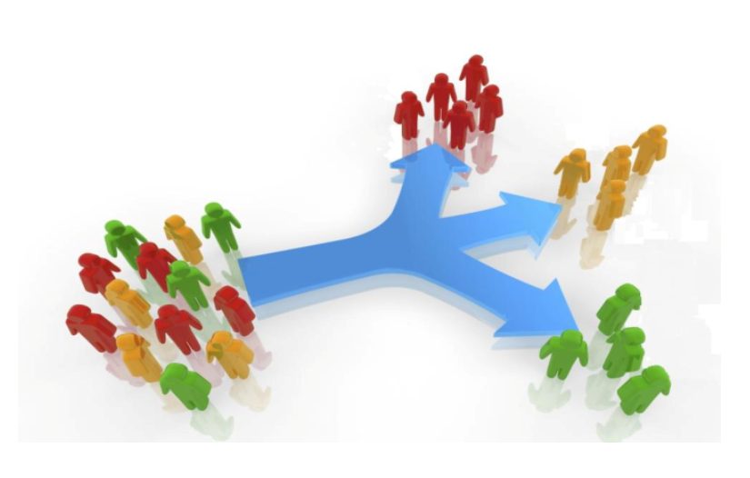
Clustering on Credit Card Dataset by K-Means
- By Sunny Satish Mhatre
PGDA Batch-43

Slide 2
INTRODUCTION
The context of credit card data analysis, can be employed to discover patterns and segments within the customer base.
The credit card dataset typically contains an excessive amount of information about individual customers, including transaction history, spending patterns, credit limits, and more.

Slide 3
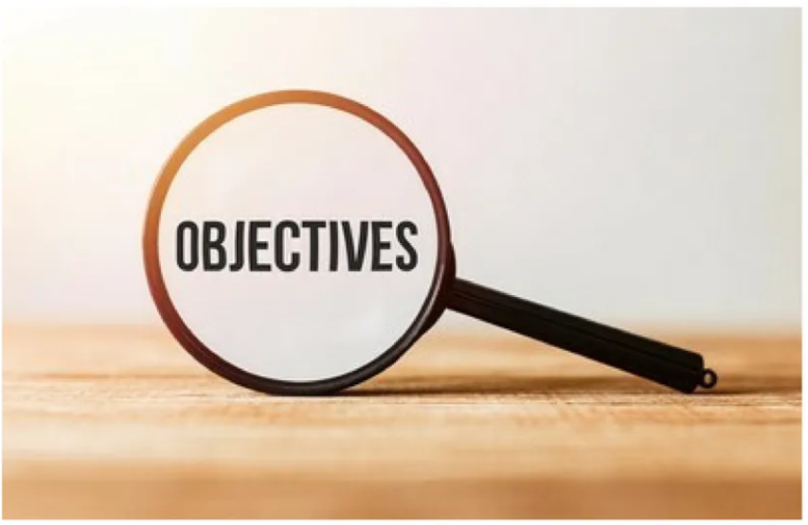
OBJECTIVE
The primary objective of clustering in the context of credit card datasets is to group transactions or cardholders based on similarities in their behavior, spending patterns, or other relevant features.

Slide 4
PROCESS FLOW
Problem Statement
Fetching Data
Data Pre-Processing & Data Visualization
Applying Algorithms
Model Building
Clustering
Business
Conclusion on Model

Slide 5

TOOLS AND PLATFROM USED
Tools: Python
Platform: Jupiter Notebook
Library Used: Scikit-learn, Pandas, NumPy, Matplotlib

Slide 6
DATA DESCRIPTION
Source of the Data – www.kaggle.com
Following is the Data Dictionary for Credit Card dataset :-
Column Name | Column Description
CUST_ID | Identification of Credit Card holder (Categorical)
BALANCE | Balance amount left in their account to make purchases
BALANCE_FREQUENCY | How frequently the Balance is updated, score between 0 and 1
PURCHASES | Amount of purchases made from account
ONEOFF_PURCHASES | Maximum purchase amount done in one-go
INSTALLMENTS_PURCHASES | Amount of purchase done in installment
CASH_ADVANCE | Cash in advance given by the user
PURCHASES_FREQUENCY | How frequently the Purchases are being made, score between 0 and 1
ONEOFFPURCHASESFREQUENCY | How frequently Purchases are happening in one-go
PURCHASESINSTALLMENTSFREQUENCY | How frequently purchases in installments are being done

Slide 7
DATA DESCRIPTION
CASHADVANCEFREQUENCY | How frequently the cash in advance being paid
CASHADVANCETRX | Number of Transactions made with "Cash in Advanced"
PURCHASES_TRX | Number of purchase transactions made
CREDIT_LIMIT | Limit of Credit Card for user
PAYMENTS | Amount of Payment done by user
MINIMUM_PAYMENTS | Minimum amount of payments made by user
PRCFULLPAYMENT | Percent of full payment paid by user

Slide 8
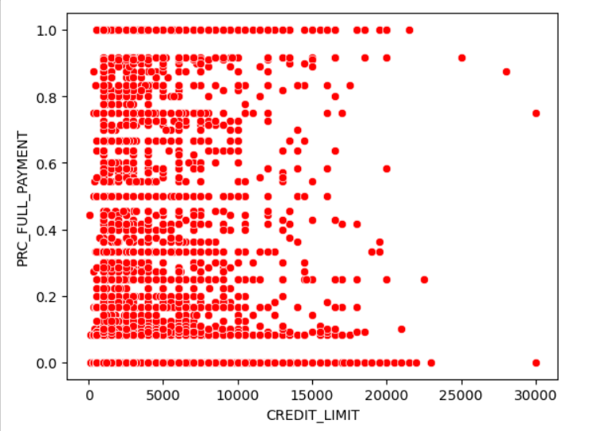
SCATTER PLOT

Slide 9
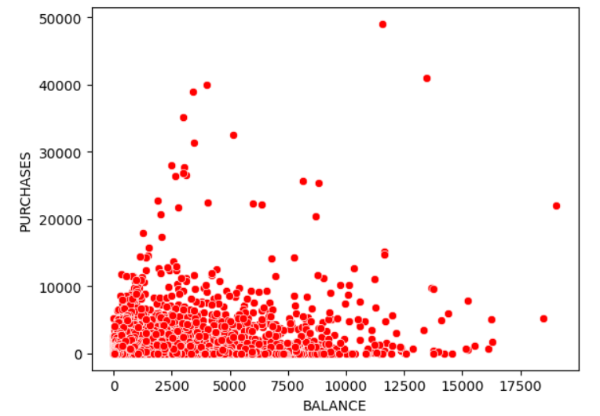
SCATTERPLOT

Slide 10
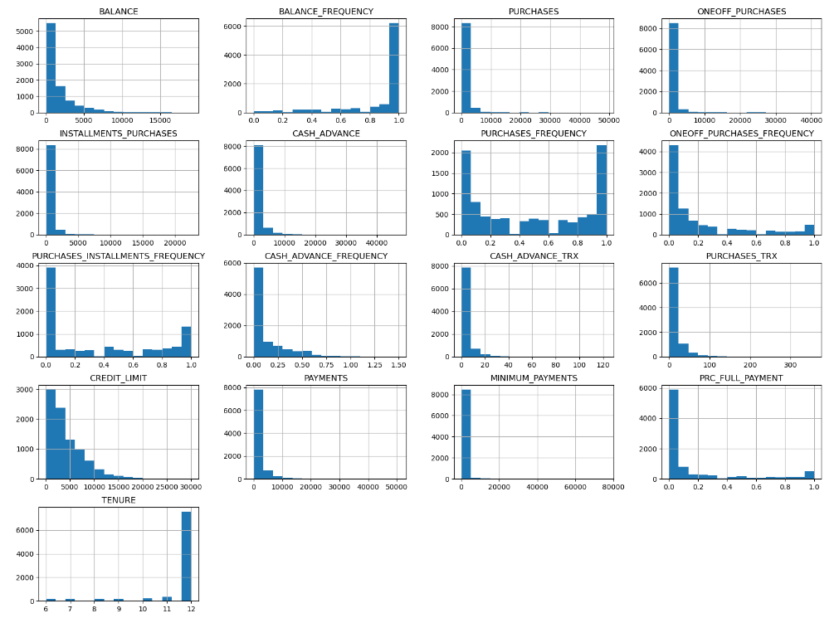
HISTROGRAM PLOT OF ALL COLUMNS

Slide 11
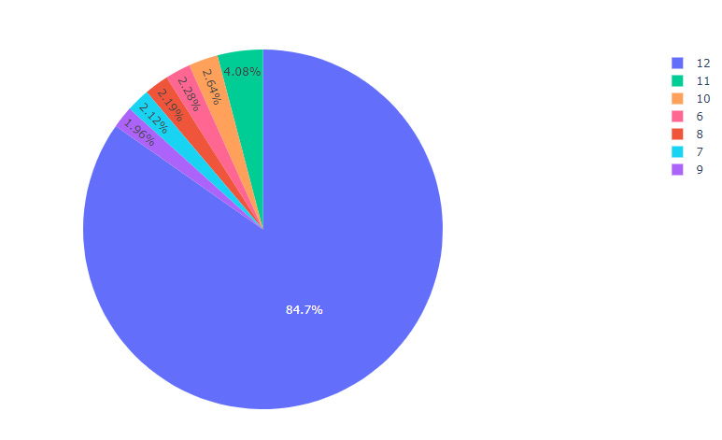
PIE CHRT ON TENURE

Slide 12
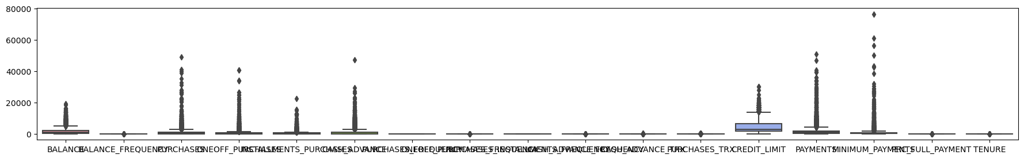
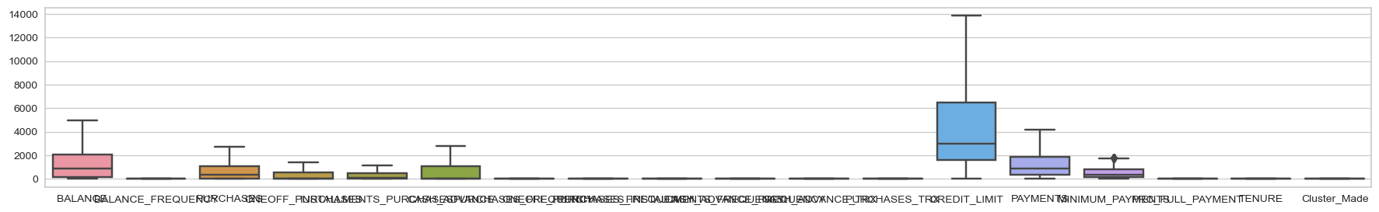
TREATMENT OF OUTLIERS
By Winsorizing Method

Slide 13
K-MEAN CLUSTERING
K-means is a popular clustering algorithm used in machine learning.
The primary goal of the K-means algorithm is to partition a dataset into K clusters, where each data point belongs to the cluster with the nearest mean (centroid).
Process of K-means
Elbow Chart
Cluster Centroid Distances
Prediction on Group

Slide 14
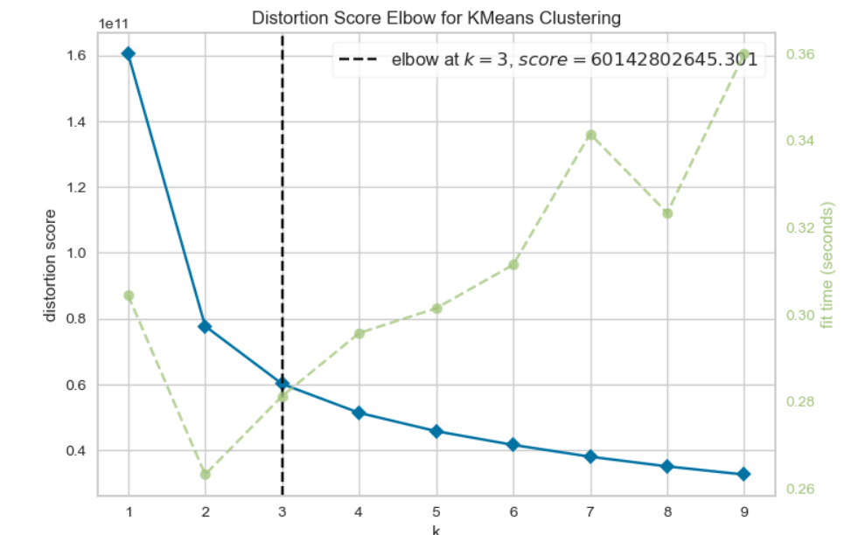
ELBOW CHART
The optimal number of clusters in a dataset is K=3.

Slide 15
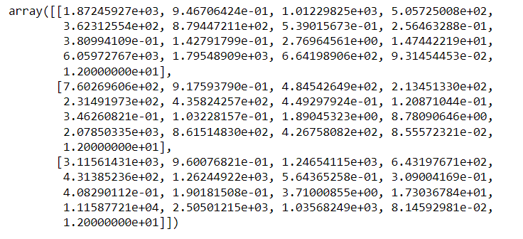
CLUSTER CENTROID DISTANCES

Slide 16
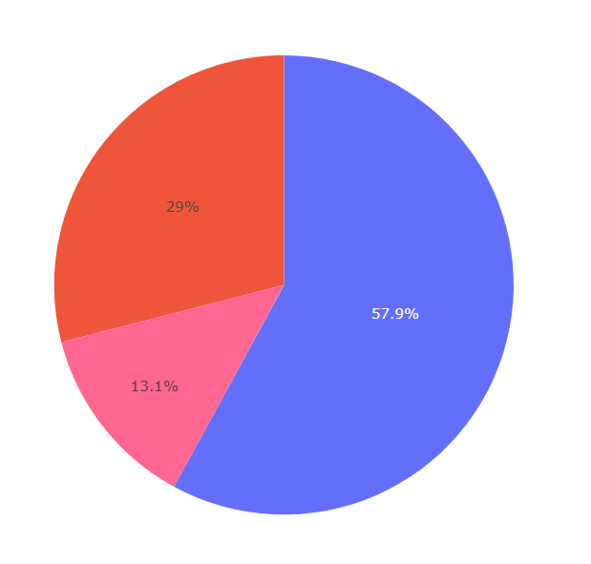
OUTPUT OF MODEL
Group 1 - 2596
Group 2 - 5185
Group 3 - 1162

Slide 17
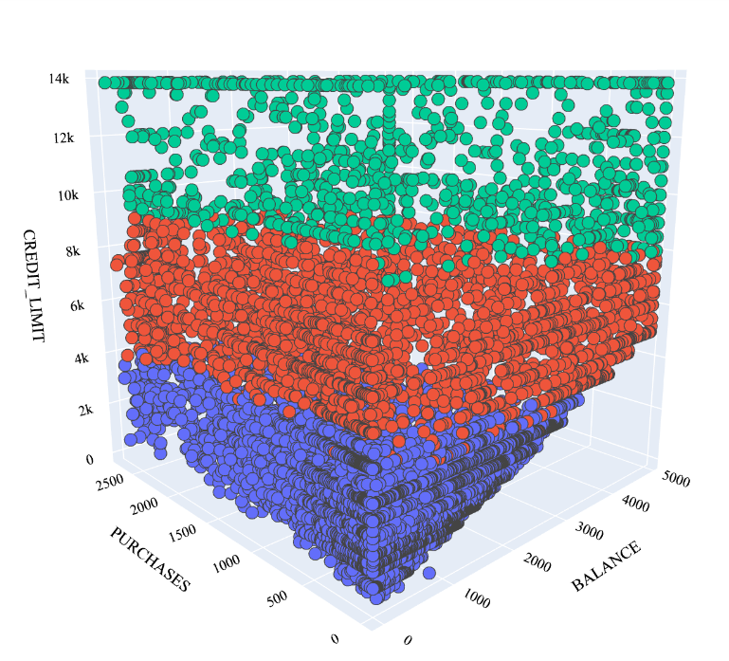
GRAPHICAL VIEW
Group 1
Group 2
Group 3

Slide 18
CONCLUSION
Starter Spenders (Group-2): This group consists of users with credit limits ranging from 0 to 4k contain 57.9%. They are likely individuals who are new to credit cards or have limited credit history.
Moderate Maximizers (Group-1): Users in this group have credit limits between 4k and 10k contain 29%. They are likely experienced credit card users who are comfortable with managing moderate levels of debt.
Elite Expenders (Group-3): This group comprises users with credit limits ranging from 10k to 14k contains 13.1% . They are high-spending individuals who have demonstrated responsible credit management and may have higher incomes. They may utilize their credit cards for larger purchases and may qualify for premium rewards and perks offered by credit card issuers.

Slide 19
BUSINESS POINT
Rewards Programs: Rewards, cashback, or loyalty points for every transaction made using the credit card. This incentivizes users to use their cards more frequently to accumulate benefits
Promotional Offers: Introducing limited-time offers, such as zero-interest(0) periods, special discounts, or bonus rewards for specific categories of spending, can entice users to increase their card usage during those periods.
Credit Limit Increases: Periodically increase a user's credit limit, making them more likely to spend more, especially if they see the higher limit as a vote of confidence from the bank.
Personalized Recommendations: Analyzing user spending patterns allows banks to provide personalized recommendations, suggesting products or services that align with the user's preferences and spending habits.
Partnerships and Alliances: Collaborate with other businesses to provide joint promotions or discounts, encouraging users to choose their credit card for transactions with partner companies.
Upgrade Offers: entice users to upgrade their credit cards to a higher-tier with added benefits, leading to increased spending to maximize those benefits.

Slide 20


